Slide 1


University of Padua
Computer-ICT Engineering
WEB APPLICATION
REMYTUTOR
Group members:
Dalla Mutta Marco
Dell’Anna Marco
Jin Xianwen
Memen Hamzah Obaid Salihi
Semencenco Victor
Ahmad Bashir Usman
10-06-2020

Slide 2
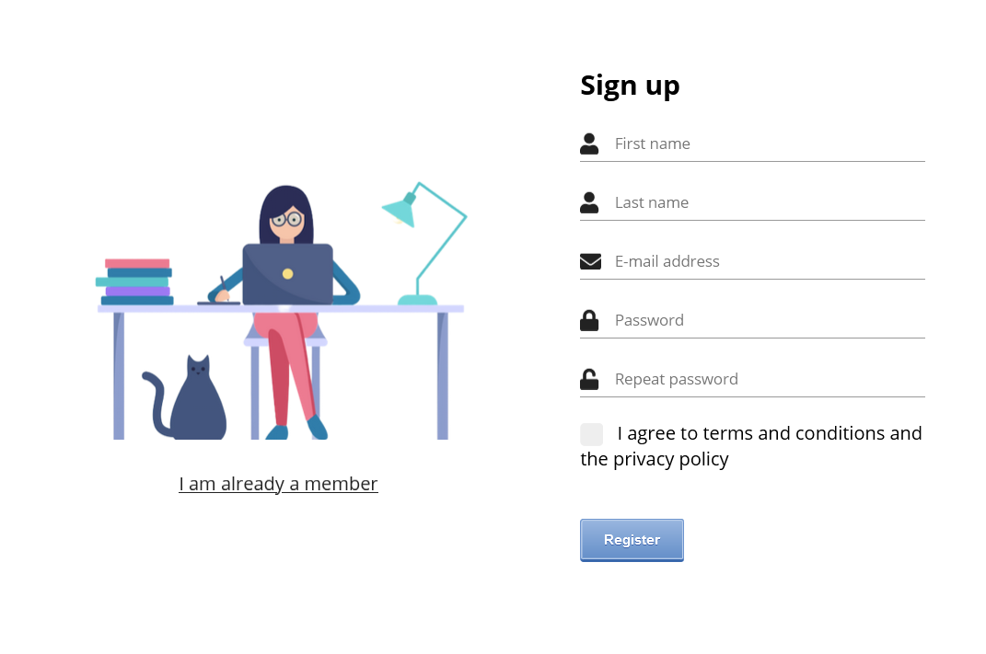
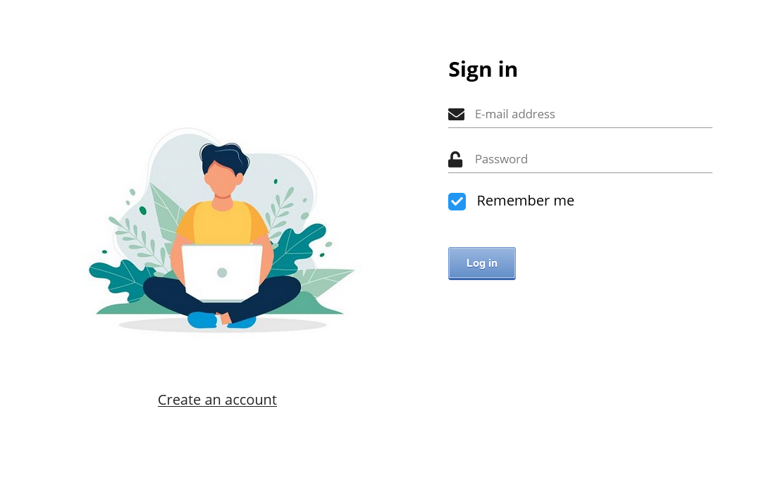
University of Padua
Computer-ICT Engineering
Web Application
For accessing our webapp's advanced features we require account creation through sign up/access thorugh sign in
10-06-2020
Presentation Remytutor

Slide 3
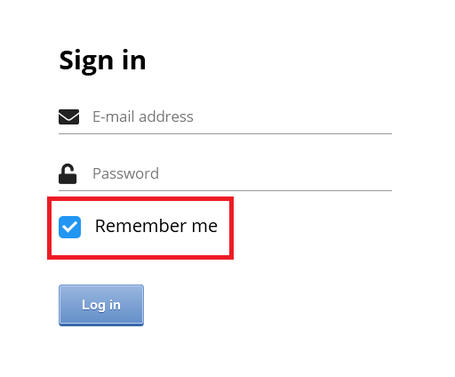
University of Padua
Computer-ICT Engineering
Web Application
Possibility to check a "Remember me" checkbox during sign in phase
Sets cookies, valid for 5 days
Every personal account page servlet checks for sign in session attribute or for the presence of these cookies
10-06-2020
Presentation Remytutor

Slide 4
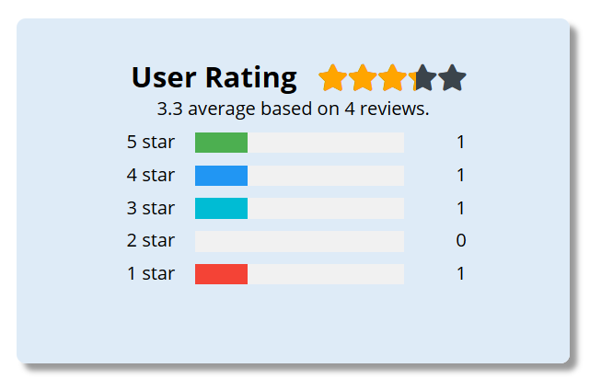
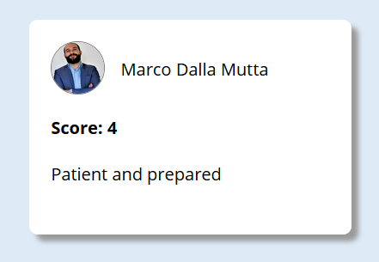
University of Padua
Computer-ICT Engineering
Web Application
Every student can give a feedback
to their teachers
These can be seen in the teacher page, but there's also a dedicated and detailed page in every user personal area
10-06-2020
Presentation Remytutor

Slide 5
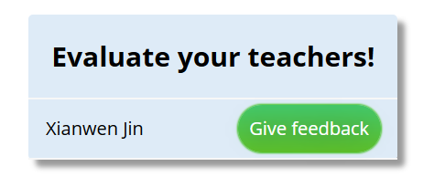
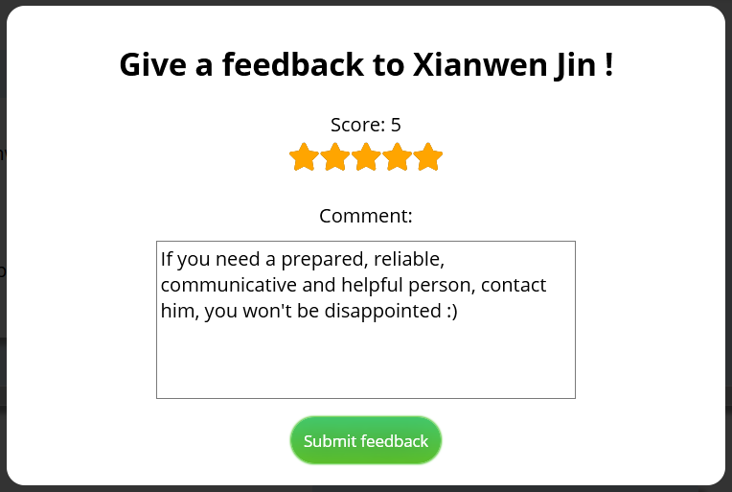
University of Padua
Computer-ICT Engineering
Web Application
In the same page resides the possibility to give a feedback
Score between 1 and 5 and, optionally, a comment
10-06-2020
Presentation Remytutor

Slide 6
University of Padua
Computer-ICT Engineering
Web Application
something
Something
10-06-2020
Presentation Remytutor

Slide 7
University of Padua
Computer-ICT Engineering
Web Application
Something
Somrthing
10-06-2020
Presentation Remytutor

Slide 8
University of Padua
Computer-ICT Engineering
Web Application
Something
10-06-2020
Presentation Remytutor

Slide 9
University of Padua
Computer-ICT Engineering
Web Application
10-06-2020
Presentation Remytutor

Slide 10
University of Padua
Computer-ICT Engineering
Web Application
Something
Something
10-06-2020
Presentation Remytutor

Slide 11
University of Padua
Computer-ICT Engineering
Web Application
10-06-2020
Presentation Remytutor

Slide 12
University of Padua
Computer-ICT Engineering
Web Application
Demo
10-06-2020
Presentation Remytutor

Slide 13
Thanks for your attention!

